Slide 1
Echolocation and Sonar
How Dolphins Use Sound

Slide 2
Echolocation Movie
Why does this person use echolocation?
What is the range this person is capable of?
Do you think you could learn to echolocate?
Notes:
https://www.youtube.com/watch?v=XUXh-X1iveU

Slide 3
Sound Sim
choose interference by reflection, then choose Pulse. Send one pulse at a time.
What do the waves do when they hit the barrier?
Notes:
http://phet.colorado.edu/en/simulation/sound
It’s best if all students have an opportunity to play with the website. Show them, and then have them play with the simulation.

Slide 4
Echo Introduction
Have you heard an echo before?
What is an echo?
What makes an echo?

Slide 5
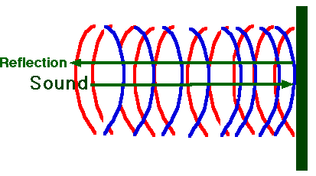
Echo
Sound hits an object and bounces back
You hear the bounce
Notes:
Image credit:
http://www.fi.edu/fellows/fellow2/apr99/sounduse.html

Slide 6
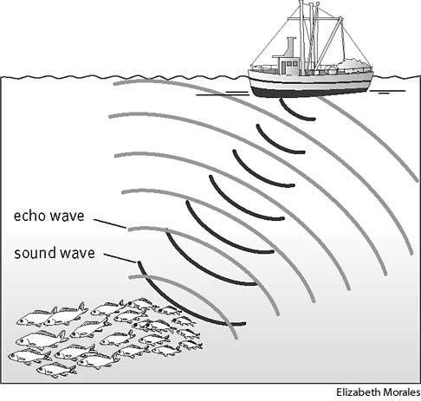
SONAR (SOund Navigation and Ranging)
This uses the idea of sound bouncing back.
Scientists know how fast sound travels in water.
Notes:
How scientists know how fast sound travels…
They send out a sound and then wait for it to come back.
The time it takes to come back tells them how far away objects are.
They need to send lots of sounds in very specific directions and then they can tell not only how far away, but where and how big the objects are.
Image credit:
http://images.yourdictionary.com/sonar

Slide 7
Bat, Dolphin and Whale Communication
Watch the video
Is it easier to see or hear the whales?
Notes:
Watch the video at http://www.dosits.org/audio/interactive/#/50
chose “Audio Gallery”, choose Humpback Whale, scroll down to the video of humpback whales off the coast of Hawaii.
After watching the video and asking the question, show the video again to ensure everyone understands
You can always hear the whales, but it is difficult to see through the murky water. The sound travels well through the water, but our eyes can’t pick up the images as clearly.

Slide 8
Types of Dolphins
Notes:
Scientists all agree that dolphins communicate with one another by using sounds and body language.

Slide 9
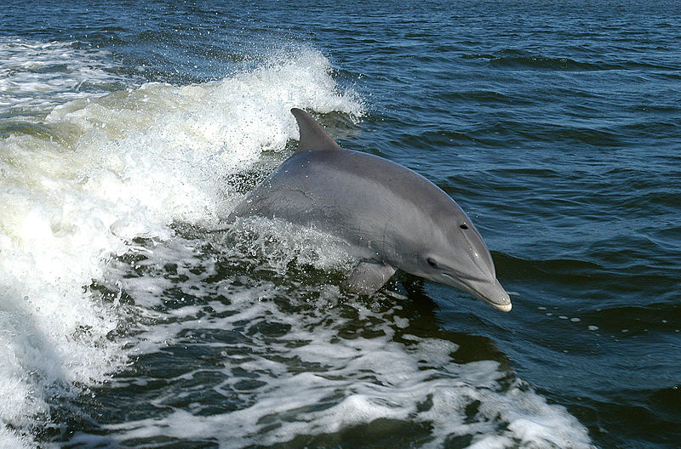
Bottlenose Dolphin Smallest of Toothed Whales
Notes:
Dolphins and porpoises are the smallest toothed whales.
Bottlenose dolphins, like Flipper the TV star, are the most familiar.
Photo credit:
http://en.wikipedia.org/wiki/File:Bottlenose_Dolphin_KSC04pd0178.jpg

Slide 10
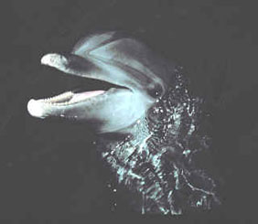
Bottlenose Dolphin
Notes:
Photo from:
http://www.dosits.org/audio/marinemammals/toothedwhales/bottlenosedolphin/

Slide 11
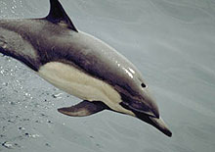
Oceanic Dolphins
Including orcas and pilot whales, there are 32 species of oceanic dolphins
Notes:
Photo from http://www.dosits.org/audio/marinemammals/toothedwhales/commondolphin/

Slide 12
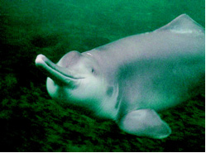
River Dolphins
There are 5 species of river dolphins
Baiji, or Yangzte River Dolphin
Notes:
Photo from: http://www.dosits.org/audio/marinemammals/toothedwhales/baiji/

Slide 13
Porpoise
Finless Porpoise
Harbor Porpoise
Notes:
There are 6 species of porpoises.
All dolphins are porpoises, but orcas and beluga whales are also porpoises.
Flipper, a bottle nosed dolphin, is the kind most people think of when they hear the word “dolphin”
Photo Credit:
http://www.dosits.org/audio/marinemammals/toothedwhales/harborporpoise/
http://www.dosits.org/audio/marinemammals/toothedwhales/finlessporpoise/

Slide 14
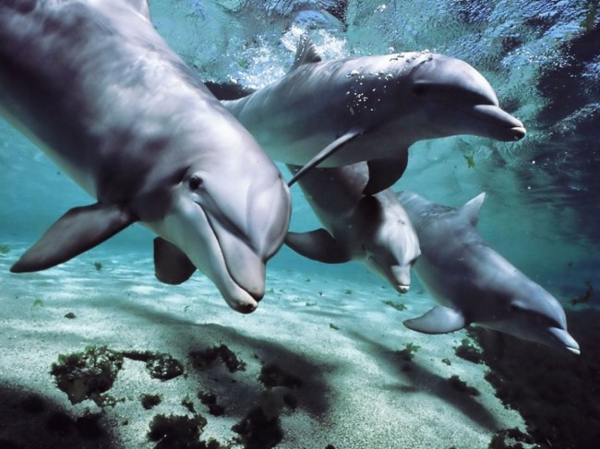
Dolphin Communication
Clicks and whistles are the two main types of dolphin vocalization.
Each dolphin has its own “signature whistle”
Dolphins recognize each others’ whistles
Notes:
Signature Whistle: This is a series of whistles (like a dolphin Morse code) distinct from any other member of the group.
Compare this to how we recognize different people’s voices
Image Credit:
http://www.digitaltrends.com/computing/translation-technology-may-let-humans-speak-with-dolphins/

Slide 15
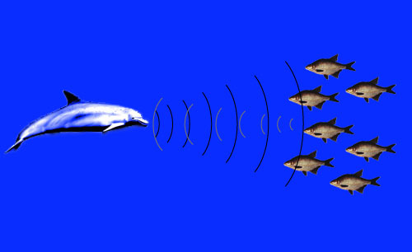
Echolocation
Some dolphins use echolocation to help them find and capture food.
Echolocation is Nature’s Sonar.
Notes:
Echolocation refers to an ability that enables bats , dolphins and whales to essentially "see" with their ears by listening for echoes.
They echolocate by producing clicking sounds and then receiving and interpreting the resulting echo.
Dolphins produce directional clicks in trains. Each click lasts about 50 to 128 microseconds.
SONAR is just human echolocation

Slide 16
Animals That Use Echolocation
Notes:
Photo credit:
http://www.dosits.org/audio/marinemammals/toothedwhales/commondolphin/
http://www.exploresound.org/Home/Acoustics-Celebs/Cindy-Moss.aspx

Slide 17
Dolphin’s Echolocation
Sound waves travel 4 times faster through water- much faster than sound travels through air!
These sound waves bounce off objects in the water and return to the dolphin in the form of an echo.
This is similar to the sound simulation and how the sounds hit the barrier and bounce back.

Slide 18
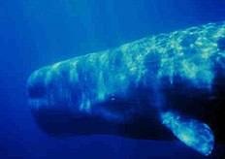
Echolocation – Click Train
What do you notice about the sounds as they
get closer?
Notes:
http://www.dosits.org/audio/marinemammals/toothedwhales/spermwhale/
Scroll down to Sperm Whale Removing Fish from Line
You may need to play this video more than once. Help students understand that the clicks get faster as the whale gets closer (to narrow location) and the whale can clearly see, but he also using echolocation in addition. (Notes: The video camera is on the bottom of the fishing line looking up. The whale isn’t stuck, he’s just holding on with his teeth.)

Slide 19
Anatomy of a Dolphin’s Head Sound Reception
Notes:
Click Trains
The click trains pass through the melon (the rounded region of a dolphin's forehead), which consists of lipids (fats).
The melon acts as an acoustical lens to focus these sound waves into a beam, which is projected forward into water in front of the animal.
Detailed Information
The major areas of sound reception are the fat-filled cavities of the lower jaw bones. Sounds are received and conducted through the lower jaw to the middle ear, inner ear, and then to hearing centers in the brain via the auditory nerve.
The brain receives the sound waves in the form of nerve impulses, which relay the messages of sound and enable the dolphin to interpret the sound's meaning.
By this complex system of echolocation, dolphins and whales can determine size, shape, speed, distance, direction, and even some of the internal structure of objects in the water.
Bottlenose dolphins are able to learn and later recognize the echo signatures returned by preferred prey species.

Slide 20
How far can Dolphins echolocate?
Some dolphins can use echolocation to detect a 15 centimeter (6 inch) long fish a football field away!
Notes:
High frequency sounds don't travel far in water.
Low frequency sounds travel farther because of their longer wavelength and greater energy.
Echolocation is most effective at close to intermediate range because dolphins and whales use high frequency sounds.
Their range is about 5-200 meters for targets 5-15 centimeters in length
This would be like clearly identifying a banana from 2 football fields away.
Image Credit: http://www.dolphins-world.com/Dolphin_Echolocation.html

Slide 21
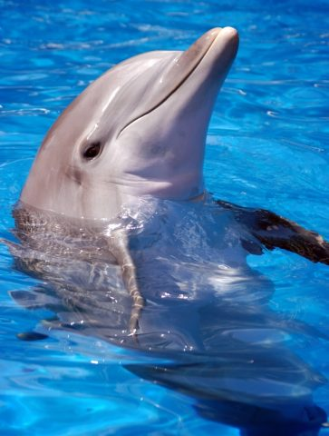
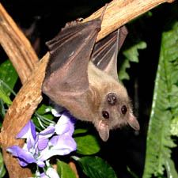
Echolocation vs. Sight
Whales and dolphins are not blind! In fact, neither are bats.
Whales and dolphins see better than bats, but both use echolocation as their primary tool.
Notes:
Despite the effectiveness of echolocation, studies show that a visually-deprived dolphin takes more time to echolocate on an object than a dolphin using vision in tandem (at the same time) with echolocation.
Image
http://www.batworld.org/
http://www.sentientdevelopments.com/2011/12/scientists-one-major-step-closer-to.html

Slide 22
Common Dolphin Sound Clips
What did you hear in each sound clip?
How are the two sounds different from each other?
Notes:
http://www.dosits.org/audio/marinemammals/toothedwhales/commondolphin/
Go to the audio gallery again and choose “common dolphin” this time and listen to the two sound clips of the dolphins.

Slide 23
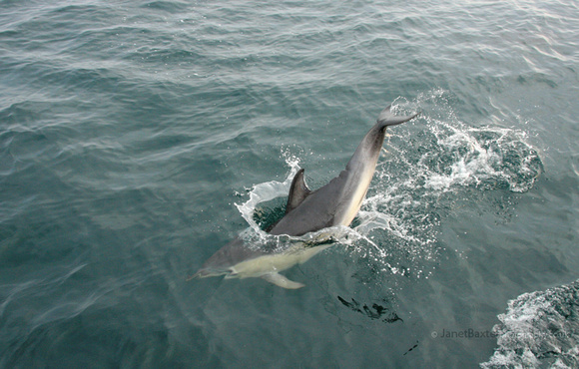
Dolphin Communication/Sounds
slapping a body part against the surface of the water
Tail or fluke slapping
Kerplunks
jaw claps
Notes:
Dolphins produce non-verbal sounds by slapping a body part against the surface of the water, which makes both a sound and a splash. Tail or fluke slapping is also common.
Kerplunks are another non-vocal sound made by the tail. Other parts of the body used to produce noise in a slapping manner are pectoral fins and the whole body.
Finally, jaw claps are made either above or underwater.
Image Credit:
http://janetbaxterphotography.co.uk/p883424850/h306A393A#h306a393a

