Slide 1


Sound and Music
Acoustical Society of America
Notes:
These slides could be used in the classroom but are designed with the intent of describing the lesson. When we tested this material with students, we did not project these slides. The teacher used them for her reference only.
Formatting notes: Bold black text are questions to ask your students to answer
Blue bold: learning goals – write these on the board.

Slide 2
What is Sound?
Students get in groups of 2 or 3.
Sit quietly and listen to the sounds around you.
Tell your group members 1 or 2 sounds that you heard.
  Today you will be Sound Detectives
Notes:
Tell them that although all these sounds seem very different, all sounds are caused by the same thing. Today they will all be sound detectives and try to find out what that thing is.

Slide 3
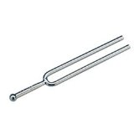
What is Sound?
Strike the tuning fork with a rubber mallet or text book.
Listen to the fork
Now look very closely at the fork while it’s making a sound.
  What do you observe?
Warning: Do not touch your glasses or teeth with the tuning fork!
Notes:
Tell them you will make a sound for them using a tuning fork. This tuning fork always makes the same clear sound. Show the learners that you are holding the rounded handle and that the two "tines" make a narrow letter "U". Show the rubber strike plate. The tines must only be struck on the strike plate, because they may become bent or broken if they are struck against a hard object.
Tuning forks should NOT be struck against hard surfaces like desks. A mallet is ideal but the heal of your tennis shoes, your knee, your palm, or a text book are good substitutes.
3

Slide 4
What is Sound?
When the fork is making a sound, touch the fork.
Touch the fork to your nose or your hand.
  What do you feel when it’s making a sound?
  What do you feel if it’s silent?
Vibrations make sound
Warning: Do not touch your glasses or teeth with the tuning fork!
Notes:
Do not touch vibrating forks to your nose. There are rumors that it can cause a nose bleed. It is fun to try eyelashes, lips (not teeth), ear lobe etc…
4

Slide 5
What is Sound?
When the fork is making a sound, how can you make the sound stop?
  What was making the sound?
Vibrations make sound
Warning: Do not touch your glasses or teeth with the tuning fork!
Notes:
Extension: This is a good time to look at other objects that make sounds with highly visible vibrations. Possible samples are musical items like a triangle, tambourine, guitar, drum, cymbal; household items like a wind-up clock with an alarm, a kitchen timer, a hand bell, wind chimes, etc. In each case the children can guess what is vibrating and check their hunches by trying to stop the sound by stopping the vibration.
5

Slide 6
What is Sound?
Set the handle end of your tuning fork on the table top.
  What happens? Why?
Sound is energy. – It can make things move.
Warning: Do not touch your glasses or teeth with the tuning fork!
Notes:
This is called “Sympathetic vibration”. Some of the energy from the tuning fork is transferred to the table and makes the table top vibrate. The table top moves a lot more air than the tuning fork does. Air moving is sound so this makes a louder sound. Notice that the table top vibrates for a shorter time than the fork alone does. Energy is conserved.
Extension: Students can place a vibrating fork on other surfaces: a chair, a file cabinet, the floor, a book, the teacher's desk, a recess ball, a lunch box, etc. Did they detect any patterns in what made the fork's sound louder? The softer? If necessary, guide their theorizing by pointing out that some things - like a rubber recess ball- have spaces filled largely with air, while others - the table- are packed quite solid. Can the vibrations move more easily through air or a solid?
(Sound travels in waves that spread onward from the source to our ears. All things are made up of molecules. The molecules in solids like metal or wood are tightly packed together and they can carry sound waves more efficiently than the spread-out molecules in air. Solids are good transmitters of sound. Sound travels through steel 15 times faster than through air. Water's good too, carrying sound four times faster than air.)
Let some children choose a new site to place their vibrating forks. Ask the class to predict whether the sound will be louder or softer (i.e., whether the sound waves will travel well or be slowed down).
6

Slide 7

What is Sound?
One student hangs a ping pong ball from the string.
Another student gently touches the quiet tuning fork to the ping pong ball.
What do you observe?
Warning: Do not touch your glasses or teeth with the tuning fork!
Notes:
Pass out one tuning fork and ping pong ball to each group. Students should work in groups of 2 or 3. The point here is to see that nothing happens when the quiet fork is touched to a ball.

Slide 8
What is Sound?
Strike the tuning fork so that it is making a sound.
Have a student touch the tuning fork to the ping pong ball again.
What happens?
Why is this?
Sound is energy. – It can make things move.
Warning: Do not touch your glasses or teeth with the tuning fork!
Notes:
The ball should bounce vigorously away from the tuning fork. The ball is very light and the fork is vibrating with a fair amount of energy so makes the ball move a lot by transferring some of its vibrational energy to the ball when touched.
8

Slide 9
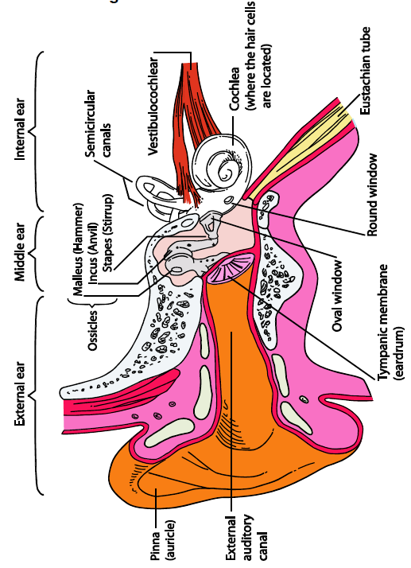
Your ear
http://www.dangerousdecibels.org
Notes:
Show the large Anatomy of the Ear poster. Ask Students if any of them have learned anything about the ear before. Let students offer ideas for a minute or so to get them thinking about the ear.

Slide 10
How We Hear
  What the outside of the ear is called?
Sound waves travel through the air,
reach the pinna and
are funneled down to the ear drum.
Notes:
Tell them that the outside of the ear is called the pinna.
It collects the sound and funnels that sound into the ear.

Slide 11
How We Hear
  What is the pink part at the end of the ear canal called?
Sound waves hit the eardrum and cause it to vibrate
Notes:
Point to the ear drum when you ask this question.

Slide 12
How We Hear
  What are these three tiny little bones?
The vibrations continue through the three tiny bones in your middle ear (the ossicles).
Notes:
These bones are the ossicles. The Malleus, the Incus and the Stapes (pronounced: stape – ees). That’s Latin for hammer, anvil and stirrup. These bones are named for their shapes.
Repeat the route again. Remember the vibrations from the tuning fork? They travel through the air and are funneled into the ear by the pinna. Then the travel down the ear canal, they hit the ear drum and make it vibrate, the ear drum vibrations make the malleus vibrate because it’s attached to the ear drum, then the incus, the stapes and then into this snail shaped thing.

Slide 13
How We Hear
  What is this snail shaped thing called?
The vibrations continue through the three tiny bones in your middle ear (the ossicles) to the cochlea.
The cochlea is filled with thousands of tiny sensors.
Notes:
Tell them it’s the cochlea. Then tell them the cochlea is filled with thousands of tiny sensors like this and hold up the hair cell poster next to the Ear anatomy poster.

Slide 14
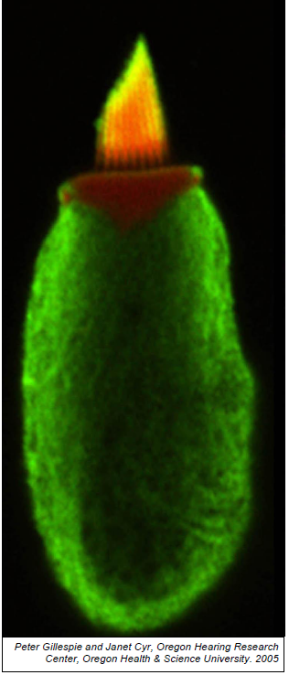
http://www.dangerousdecibels.org

Slide 15
How We Hear
  Does anyone know what this is called?
The cochlea is filled with thousands of tiny sensors called hair cells.
Notes:
Tell them it’s called a hair cell.

Slide 16
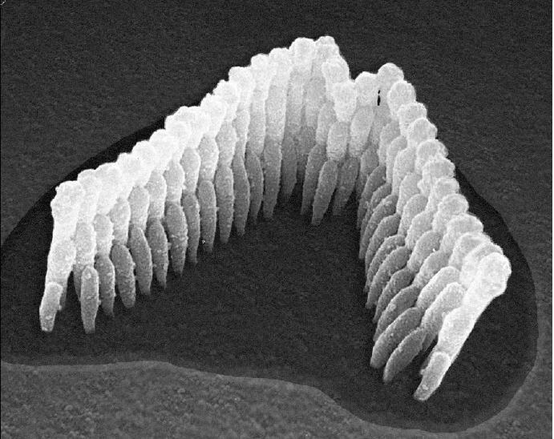
One Inner Ear Hair Cell
Large Cell body with hair bundle on top
Hair Bundle (yellow/orange)
Black and white photo of one hair bundle
Hair Cell (green)
http://www.dangerousdecibels.org
Notes:
When you listen to loud sounds, you can actually damage these hair cells.
Hold up the healthy hair bundle poster. Tell them this is what healthy hair cells look like.
Hold up the

Slide 17
The Inner Ear
What does this look like to you?
These hair cells turn vibrations into electrical signals that are sent to the brain, and the brain interprets the source of the sound (piano vs. a guitar).
The green part is the cell body.
The yellow part are the hair bundles
Notes:
It’s fun to ask students to tell you what they think the hair cell looks like. You might get candle or other choices but our favorite is flaming pickle!
These hair cells are what turns those vibrations into electrical signals that are sent to the brain so your brain can interpret what the sound is. Whether it’s a piano playing, someone playing a guitar or me talking. Or maybe a fire alarm.
When you listen to loud sounds you can actually damage these hair cells. It’s the hair bundle at the top that can actually be damaged when you listen to your music too loud or you are around some loud sounds too long.

Slide 18
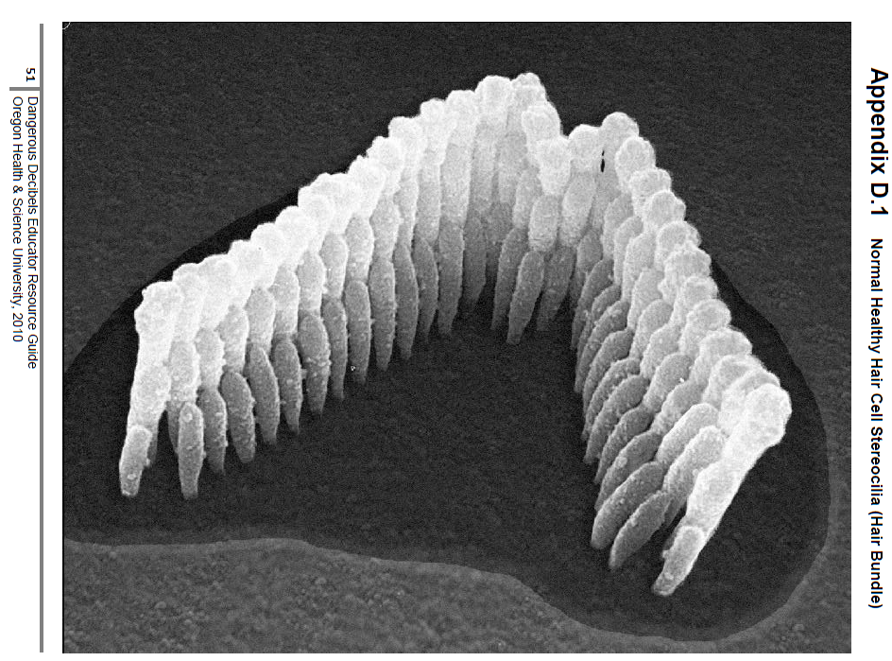
Here is a normal hair bundle.
Notes:
These are the healthy hair cells. The yellow part of the flaming pickle. See how they are standing straight up.

Slide 19
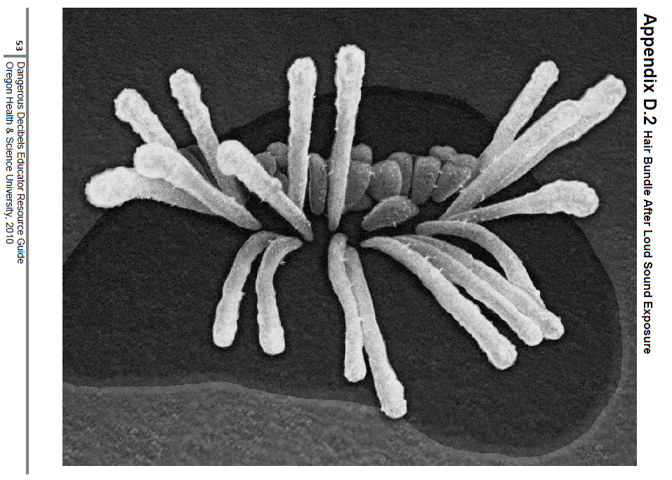
What could have caused this?
Notes:
Hold the two hair bundle posters next to each other.
These are damaged hair cells. The loud sounds have bent and broken them.

Slide 20
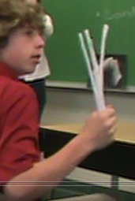
Build a Model
Have any of you ever made a model at home or school?
We’re going to pretend our arm is something.
What is your arm? Any ideas?
Notes:
Pass out 5 or more pipe cleaners per student. Tell them not to bend them or mess with them yet!
As you pass out the pipe cleaners ask students if they’ve ever made a model before.
After soliciting several responses from students, tell them that today we’re going to make a model of the inner ear.
Have them make a fist and hold it out. That’s the green/pickle part,…the body of the hair cell
Put the pipe cleaners in your fist. That is the hair bundle.
We’re going to pretend our arm is something. Can anyone tell me what it might be? It’s the nerve taking the signal from the hair cells to the brain.

Slide 21
Build a Model
  We’re going to go to the fireworks show.
  First we have to mow the lawn.
  Is the lawn mower loud?
Notes:
Tell the students a story about going to the fireworks show.
Your sitting at the table talking to your parents.
Show students how to gently brush their hands back and forth over the fuzzy sticks as your Dad talks to you nice and quiet.
Dad says we’re going to the fire works show today. We get to sit in the (insert your stadium name here) stadium – the best seats there are!
But if you want to go, you you have to mow the lawn first.
Do you guys think a lawn mower is kind of loud?
Ok, so we’re going to go out to the yard and start the lawn mower. It’s going to get a little louder so brush your hair cells a little harder (not too hard). A typical lawn mower is actually a safe sound for up to 2 hours. Is your yard safe? It depends on how big your yard is!

Slide 22
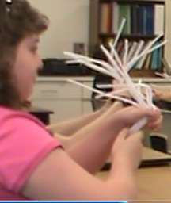
Build a Model
  Fireworks show!
  How loud are fire works if you get really close?
  What do your hair bundles look now?
  Can you fix them?
  Loud sounds carry more energy than soft sounds.
  Listening to loud sounds for too long can damage the hair cells, and these can’t be fixed.
Notes:
Now we get to go to the (insert local name here) stadium.
How loud are fireworks if you get really really close?
We’re pretty excited and then they start! Boom!, bang, boom. Have students hit their hair bundles hard now as their hands go past.
Ok, What do you hair bundles look like now? Can you fix them?
That’s what happens in our ears, these are nerve cells and we can’t regrow them. Unless you’re a bird or a frog.

Slide 23
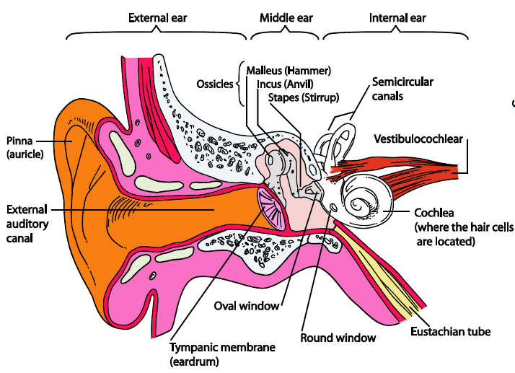
Your Ear
Pretty amazing organ
  Play each frequency found here: http://www.noiseaddicts.com/2009/03/can-you-hear-this-hearing-test/
  Raise your hands when you hear the sound.
  High pitch is a high sound
Notes:
Optional if you do not have a computer with speakers.
Students really enjoy getting to hear the high sounds and seeing what they are able to hear. Not everyone’s ears are the same, some are more sensitive so if you can’t hear the 18,000 Hz, even when you’re young, it doesn’t have to be because of damage.
Students love to see that they can hear high sounds better than their teacher! Most adults can’t hear higher than 12 – 15,000 Hz.
Use the words “low pitch” and “high pitch”

Slide 24
Your Voices
Hold your fingers on the front of your throat and say Aaaah
Notice the vibration?
Vibrations make sound.
Now make a high Aaaah and a low Aaaaah
High pitch is a high sound.
Do low and high voices feel different?
High pitch has a higher rate of vibration – more wiggles per second.

Slide 25
Straw Instrument cup instrument as alternative
Take the straw and the scissors, and cut off the tip of the straw to a point, like so. (Try to get both sides to be the same.)
Now, gently chew on the straw to soften the tip, and to get the edges to be smooshed together. You would like the straw just below the two tips to be almost touching.
Now, put the pointy end in your mouth, and blow really hard. If you do it right (it might take some practice), you will get a very loud sound from the straw instrument!
Cut tip of straw like so…
Notes:
Some students will chew with their side teeth and not get the straw very warm. We’ve seen a few who do this have trouble making sound. Instruct the students to chew on the straw with their lips closed, this helps it soften up and work better.

Slide 26
Straw Instrument
What is vibrating?
Vibrations make sound.
Notes:
The tips of the straw are vibrating. If students are having trouble figuring this out, suggest that they gently touch their tongue to the tips of the straw while they make a sound. They will feel it tickling their tongue.

Slide 27
Straw Instrument
Does the person across the room hear your straw instrument?
Does the air you blow into the straw go in his/her ear for them to hear?
Sound is energy it travels through air, air is not the sound.

Slide 28
Straw Instrument
Sound is energy. It travels through air, but air is not the sound.
If you have bad breath (eat tuna) can the person across the room smell it when they hear you talk?
Why is that?

Slide 29
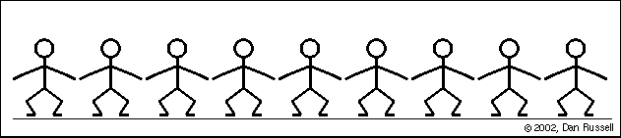
Sound travels
Do the wave :
Did the wave make it across the room?
How did you move?
Did the people who started it move across the room?
http://www.acs.psu.edu/drussell/Demos/waves-intro/waves-intro.html
Notes:
Name a student or two who were at the beginning of the wave. Ask them if they went with the wave across the room.

Slide 30

Sound travels
Air moves back and forth as sound energy goes past.
http://www.acs.psu.edu/drussell/Demos/waves-intro/waves-intro.html
Sound is energy. It travels through the air, but air is not the sound..
Notes:
Extension: If you have a computer in the room, show the PhET “Sound” simulation. Choose the last tab – “Listen with Varying Pressure”. What happens to the sound when the air is removed from the box?

Slide 31
Straw Instrument
Put the bigger straw over the end of your straw instrument. This makes a sort of straw trombone!

Slide 32
Straw Instrument
Make the lowest pitch, bass notes, that you can.
Make the highest pitch, treble notes, that you can.
High pitch is a high sound.
Notes:
When the two straw combination is as long as possible, you can get the lowest sounds.

Slide 33
Straw Instrument
Is the buzzing on your lips different with low and high sounds?
High pitch has a higher rate of vibration.

Slide 34
Straw Instrument
☺
You get to keep your straw instruments.
Put the straw instruments away (not just on desk, out of sight.)

Slide 35
Resonance
Frequency: rate: wiggles per second (moves back and forth).
Resonant, or natural frequency: the frequency at which an object likes to vibrate
Notes:
Extension: There is an activity called “How musical Instruments Work” that helps students sort out the difference between resonance and sympathetic vibration and what their roles are in musical instruments. This activity is recommended as a follow on to Musical Instruments I and II.

Slide 36
Pasta Demo
Why does the longer pasta shake more when the hand is moved slowly?
Here is a video of the pasta raisin demonstration: http://www.youtube.com/watch?v=MA8WEFhA3DM&feature=player_embedded
Notes:
This is a demo done by the teacher. There is a video link here so you can see how it works but it’s MUCH better if the teacher does the demo than just showing the video. The teacher will have three sticks of pasta in their hand. Each one held with a different length above the hand. Each stick of pasta has a raisin or marshmallow stuck on the end for weight. When you shake your hand slowly, the long pasta will swing vigorously back and forth. When you shake at medium frequency, the middle one will and the other two just jiggle. If you can shake fast enough, the short one will wave vigorously and the other two just wiggle. If you do any of the three fast enough, the pasta will snap off.

Slide 37
Resonance
Longer pasta shakes at lower frequencies.
Lower frequencies have longer wavelengths.
Remember: Low pitch is a low sound,
and low pitch has less wiggles per second
Pitch is how we hear wiggles per second that air shakes. Pitch is how we hear frequency.

Slide 38
Straw resonance
Straws are similar. Different lengths of straws like different frequencies or pitches.
Air moves a lot at the resonant frequency (like the pasta) so the sound is loud.
For a low (bass) frequency was your straw longer or shorter?
Low frequencies have longer wavelengths.

Slide 39
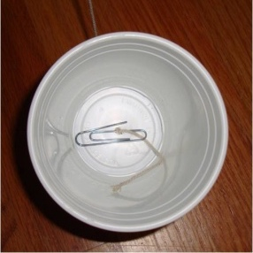
Cup Instrument
Vibrations make sound.
What do you think will happen if you make the string shorter?
Notes:
Teacher demonstration. Have one student come to the front of the room and help you play the cup instrument. Tie the string to a table leg (don’t try to just hold it) and pull the cup very tight. Then have a student pluck the string. Show how it sounds without the cup (hold the string just before the cup so the vibrations cannot travel into the cup). Then show them how the sound changes if the string is shorter or longer when the cup is being used to amplify the sound.
Extension: The activity called Musical Instruments part II is an entire lesson that utilizes the cup instrument and investigates other stringed instruments.

Slide 40
Cup Instrument
Resonant frequency: The frequency an object likes to vibrate.
Lower frequencies have longer wavelengths.

Slide 41
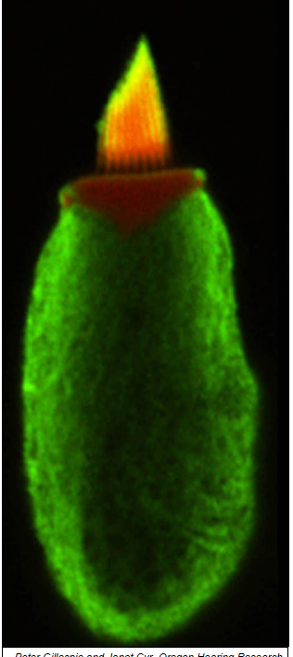

Sound is made from vibrations
The vibrations travel through the earcanal, eardrum, ossicles – the three tiny bones and then into the cochlea.
Different parts of the cochlea resonate with certain frequencies ....
Some like high pitches and
Some like low pitches…
The hair cells sense the sound and send electrical signals to your brain.
Notes:
Review what we’ve learned and put ideas together. Different parts of the cochlea have different resonant frequencies so are sensitive to different pitches. The hairs in the front of the cochlea sense higher sounds and the hairs towards the back are sensitive to lower sounds. This is partly due to the tension of the basiler membrane in different parts of the cochlea. The hair cells in the front typically get damaged first since they are closer to the sound. This means when you have hearing damage the sound is messed up, not just quieter.
Extension: There is a game on the Dangerous Decibels virtual lab that lets you hear what different sounds will sound like if you have hearing damage.

